Slide 1
Track Pocket App
Personal expenses management application

Slide 2
Content
Purpose
Introduction
  Problem specification
  Requirements specification
Objectives
Functional Requirements

Slide 3
Purpose
My aim is to develop a Expenses tracking system. This applicaion is a web application typically used to manage day-to-day income and expenses.
From this application, I am going to demonstrate about development technologies like java, spring, ReactJS, MySQL and microservices architecture.

Slide 4
Introduction
Track Pocket app is used to manage our day-to-day income and expenses. It helps users to manage their income within their budget limits.
Using this application we can,
  Make efficient track of our transactions
  Limit expenses
  Identify the major expense requirements
  Reduce time wastage of manual tracking and calculations

Slide 5
Requirement Specification
User access for multi users.
Transaction details with a
  Transaction identification number
  Transaction type
  Transaction category
  Amount
  Date
  Note
Update and delete transactions
Create and delete transaction categories
Specify budget limits for expense categories
View latest transactions

Slide 6
Objectives
General
  Developing an application to allow a userto track day-to-day expenses and limit expenses
Specific
  To implement interfaces for permission control and allow user handling
  To allow the user to track transactions,set budget limits for transaction categories and view them in different classifications

Slide 7
Functional Requirements
User Management (User Service)
Transaction Management (Transaction Service)
Category Management (Category Service)

Slide 8
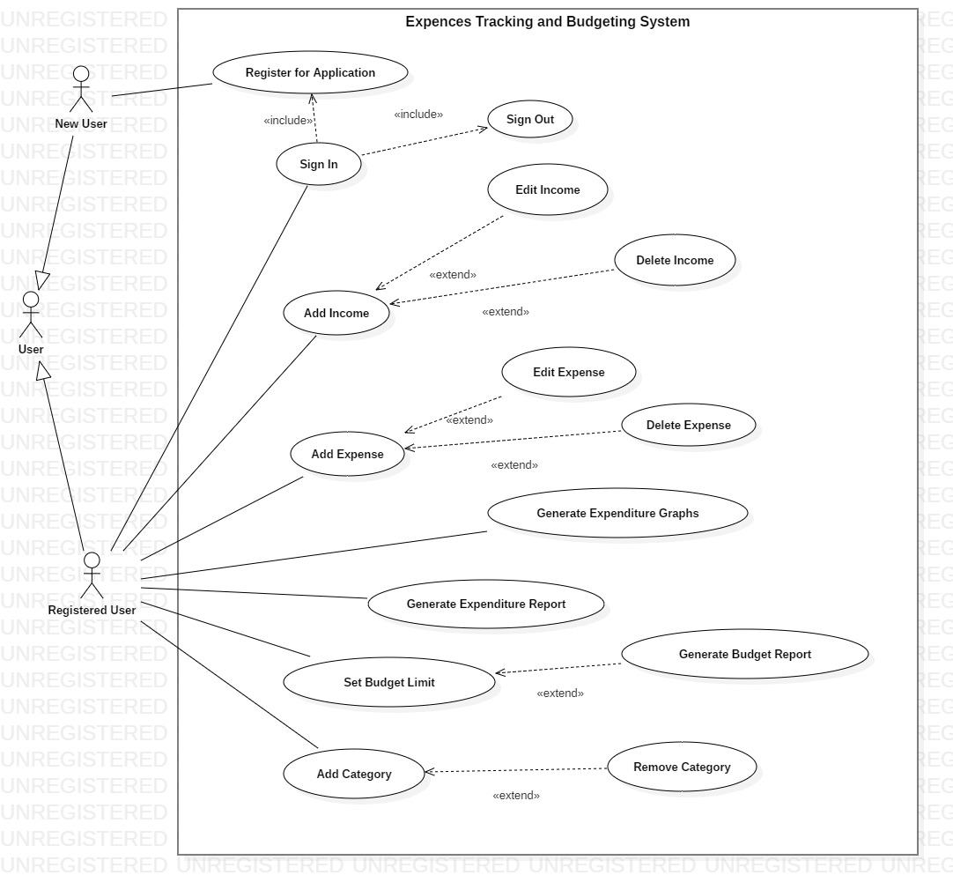
Use Case Diagram

Slide 9
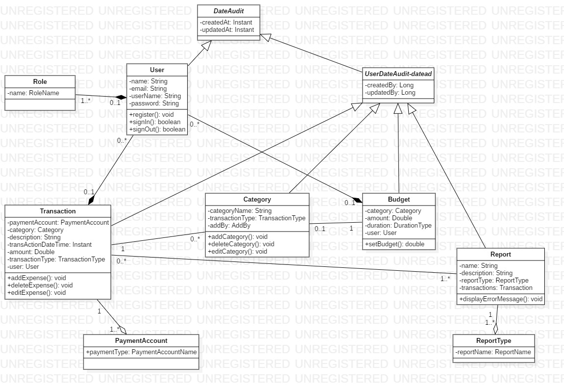
Class Diagram

Slide 10
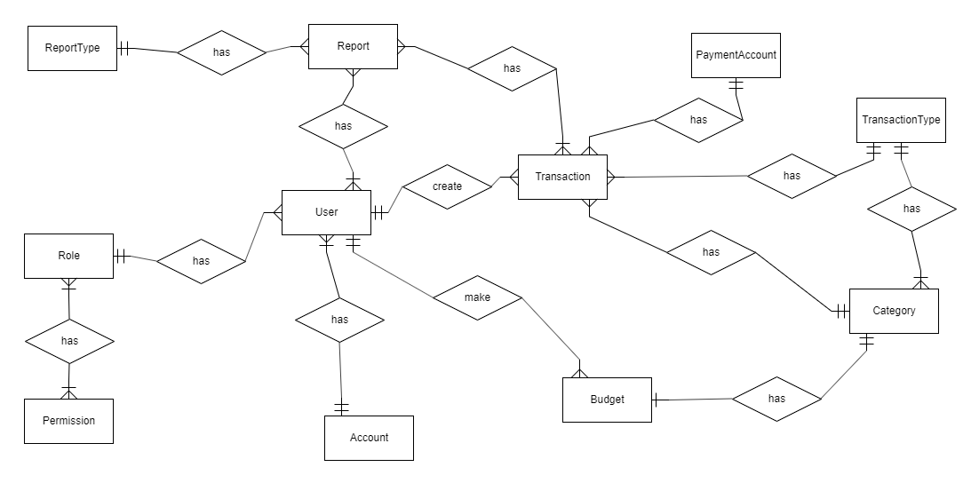
ER Diagram

Slide 11
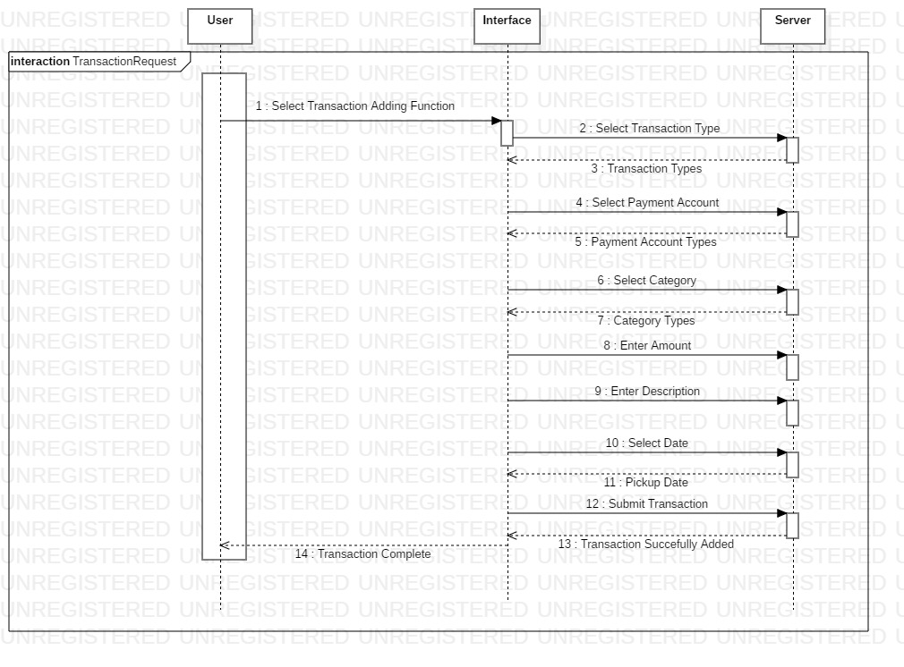
Sequence Diagram for transaction request

Slide 12
Thank you..!

